Slide 1
KEYNOTE-811: First-line treatment (pembrolizumab plus trastuzumab and chemotherapy) of locally advanced unresectable or metastatic HER2-positive gastric or gastro-oesophageal junction adenocarcinoma
These slides are provided to UK healthcare professionals as a data resource for personal education.
To ensure compliance with all relevant codes and regulations, these slides must not be amended and should only be downloaded with the latest prescribing information. Prescribing information and further safety information for Great Britain and Northern Ireland can be found at the footer of this slide.
Please refer to the full KEYTRUDA® (pembrolizumab) Summary of Product Characteristics and Risk Minimisation Materials for patients before prescribing KEYTRUDA
Adverse events should be reported. Reporting forms and information can be found at https://yellowcard.mhra.gov.uk/ (please note that the MHRA Yellow Card link will redirect you to an external website, for which MSD does not review or control the content) or search for MHRA Yellow Card in the Google Play or Apple App Store. Adverse events should also be reported to Merck Sharp & Dohme (UK) Limited (Tel: 020 8154 8000).
FOR UK HEALTHCARE PROFESSIONALS ONLY
Please click the following links for the KEYTRUDA Prescribing Information: Great Britain; Northern Ireland.
Copyright © 2024 Merck & Co., Inc., Rahway, NJ, USA and its affiliates. All rights reserved.
GB-ESO-00022 Date of preparation: January 2024
GB-ESO-00024 Date of preparation: January 2024

Slide 2
KEYTRUDA® (pembrolizumab) licensed indication
KEYTRUDA, in combination with trastuzumab, fluoropyrimidine and platinum-containing chemotherapy, is indicated for the first-line treatment of locally advanced unresectable or metastatic HER2-positive gastric or GOJ adenocarcinoma in adults whose tumours express PD-L1 with a CPS ≥1
GB PI
NI PI

Slide 3
Slide deck navigation
Click the links below to navigate to the section of interest
Gastric cancer overview
KEYNOTE-811: Overview
KEYNOTE-811: Results
KEYNOTE-811: Summary
Appendix
To access the navigation page, click the ‘Home’ icon
The links in this slide deck will redirect you to third-party websites where indicated. Please note that:
MSD does not review or control the content of any third-party website
MSD does not endorse and is not responsible for the accuracy, content, practices or standards of any third-party sources
GB PI
NI PI

Slide 4
In the UK, there are ~4200 deaths due to gastric cancer per yearª
Gastric cancer is the 17th most commonly diagnosed cancer in the UK^{b}
In the UK, approximately 6500 new cases of gastric cancer are diagnosed each year^{b}
Approximately 17% of patients with gastric cancer in England will survive their cancer for ≥10 years^{c}
Gastric cancer has the highest incidence rate in those aged 85–89 years^{b}
2 in 3 cases of gastric cancer are in men^{b}
ªData collected from 2017–2019; ^{b}Data collected from 2016–2018; ^{c}Data collected from 2013–2017. PI, prescribing information. Cancer Research UK. Stomach cancer statistics. Available at: https://www.cancerresearchuk.org/health-professional/cancer-statistics/statistics-by-cancer-type/stomach-cancer. Accessed January 2024.
GB PI
NI PI

Slide 5
Limited treatment options are available for HER2-positive gastric or GOJ cancer since the introduction of HER2-targeted therapy over a decade ago
Patients with HER2-positive tumours
HER2-positive gastric and GOJ cancer treatment options
IO therapy
~15–20% of people with advanced gastric or GOJ cancer have HER2-positive tumours^{1,2}
Over the past decade, there have been limited treatment options for patients with HER2-positive gastric or GOJ cancer³
Studies conducted in recent years showed that the addition of IO to chemotherapy improved clinical outcomes in patients with advanced HER2-negative gastric or GOJ cancer compared with chemotherapy alone⁴
KEYNOTE-811 provides an alternative treatment option for patients with advanced HER2-positive gastric or GOJ cancer³
GB PI
NI PI

Slide 6
KEYNOTE-811: Study design^{1,2}
Multicentre, randomised, double-blind, placebo-controlled Phase 3 trial
Patients enrolled from 5 October 2018 to 6 August 2021 (N=698)
KEYTRUDAª 200 mg IV Q3W
+
Trastuzumab 8 mg/kg IV on first infusion and 6 mg/kg in subsequent cycles Q3W +
FP^{b} or CAPOX^{c}
Click here for HER2 testing methodology
n=350²
Key eligibility criteria
Advanced gastric or GOJ adenocarcinoma
HER2-positive
ECOG PS 0 or 1
No prior systemic treatment for metastatic disease
Patients were treated until unacceptable toxicity, disease progression or for a maximum of 35 cycles (~24 months)
R 1:1
(N=698)
Placeboª 200 mg IV Q3W
+
Trastuzumab 8 mg/kg IV on first infusion and 6 mg/kg in subsequent cycles Q3W +
FP^{b} or CAPOX^{c}
Dual primary endpoints: PFS per RECIST v1.1 by BICR and OS
Secondary endpoints: ORR and DOR per RECIST v1.1 by BICR and safety
Stratification factors at randomisation
Geographic region
PD-L1 CPS (≥1 vs <1)
Investigator’s choice of chemotherapy (FP vs CAPOX)
n=348²
GB PI
NI PI

Slide 7
KEYNOTE-811: Baseline characteristicsª
Characteristic | KEYTRUDA + trastuzumab + FP or CAPOX (n=350) | Placebo + trastuzumab + FP or CAPOX (n=348)
Age, median (IQR), years | 62 (54–69) | 63 (55–70)
Aged ≥65 years, n (%) | 145 (41) | 156 (45)
Male sex, n (%) | 284 (81) | 280 (80)
Race, n (%)
White | 218 (62) | 212 (61)
Asian | 119 (34) | 118 (35)
Black or African American | 2 (1) | 2 (1)
ECOG PS, n (%)
0 | 146 (42) | 146 (42)
1 | 204 (58) | 202 (58)
Metastatic sites, n (%)
0–2 | 179 (51) | 198 (57)
≥3 | 171 (49) | 150 (43)
Primary location at diagnosis, n (%)
GOJ | 110 (31) | 122 (35)
Stomach | 240 (69) | 226 (65)
Characteristic | KEYTRUDA + trastuzumab + FP or CAPOX (n=350) | Placebo + trastuzumab + FP or CAPOX (n=348)
PD-L1 status, n (%)
CPS ≥1 | 298 (85) | 296 (85)
CPS <1 | 52 (15) | 52 (15)
MSI-H status, n (%)
MSI-H | 6 (2) | 2 (1)
Non-MSI-H | 326 (93) | 329 (94)
Unknown | 18 (5) | 17 (5)
Geographic region, n (%)
Australia/Europe/Israel/North America | 113 (32) | 111 (32)
Asia | 118 (34) | 119 (34)
Rest of world | 119 (34) | 118 (34)
Chemotherapy regimen, n (%)
CAPOX | 297 (85) | 299 (86)
FP | 53 (15) | 49 (14)
Adapted from Janjigian YY et al. 2023.
GB PI
NI PI

Slide 8
KEYNOTE-811: Primary endpoint – PFS in the ITT population
IA2
Median (IQR) follow-up time: 28.4 (19.7–34.3) months
PFS, months | KEYTRUDA + trastuzumab + FP or CAPOX (n=350) | Placebo + trastuzumab + FP or CAPOX (n=348)
Median (95% CI) | 10.0 (8.6–11.7) | 8.1 (7.0–8.5)
KEYTRUDA is licensed for use in combination with trastuzumab and chemotherapy for the first-line treatment of locally advanced unresectable or metastatic HER2-positive gastric or GOJ adenocarcinoma in adults whose tumours express PD-L1 with a CPS ≥ 1.
The results for the ITT population are presented as this is the primary endpoint of the study. It allows the results in the licensed population (a sub-group of the ITT population) to be viewed in context of the primary endpoint.
Figure adapted from Janjigian YY et al. 2023.
GB PI
NI PI

Slide 9
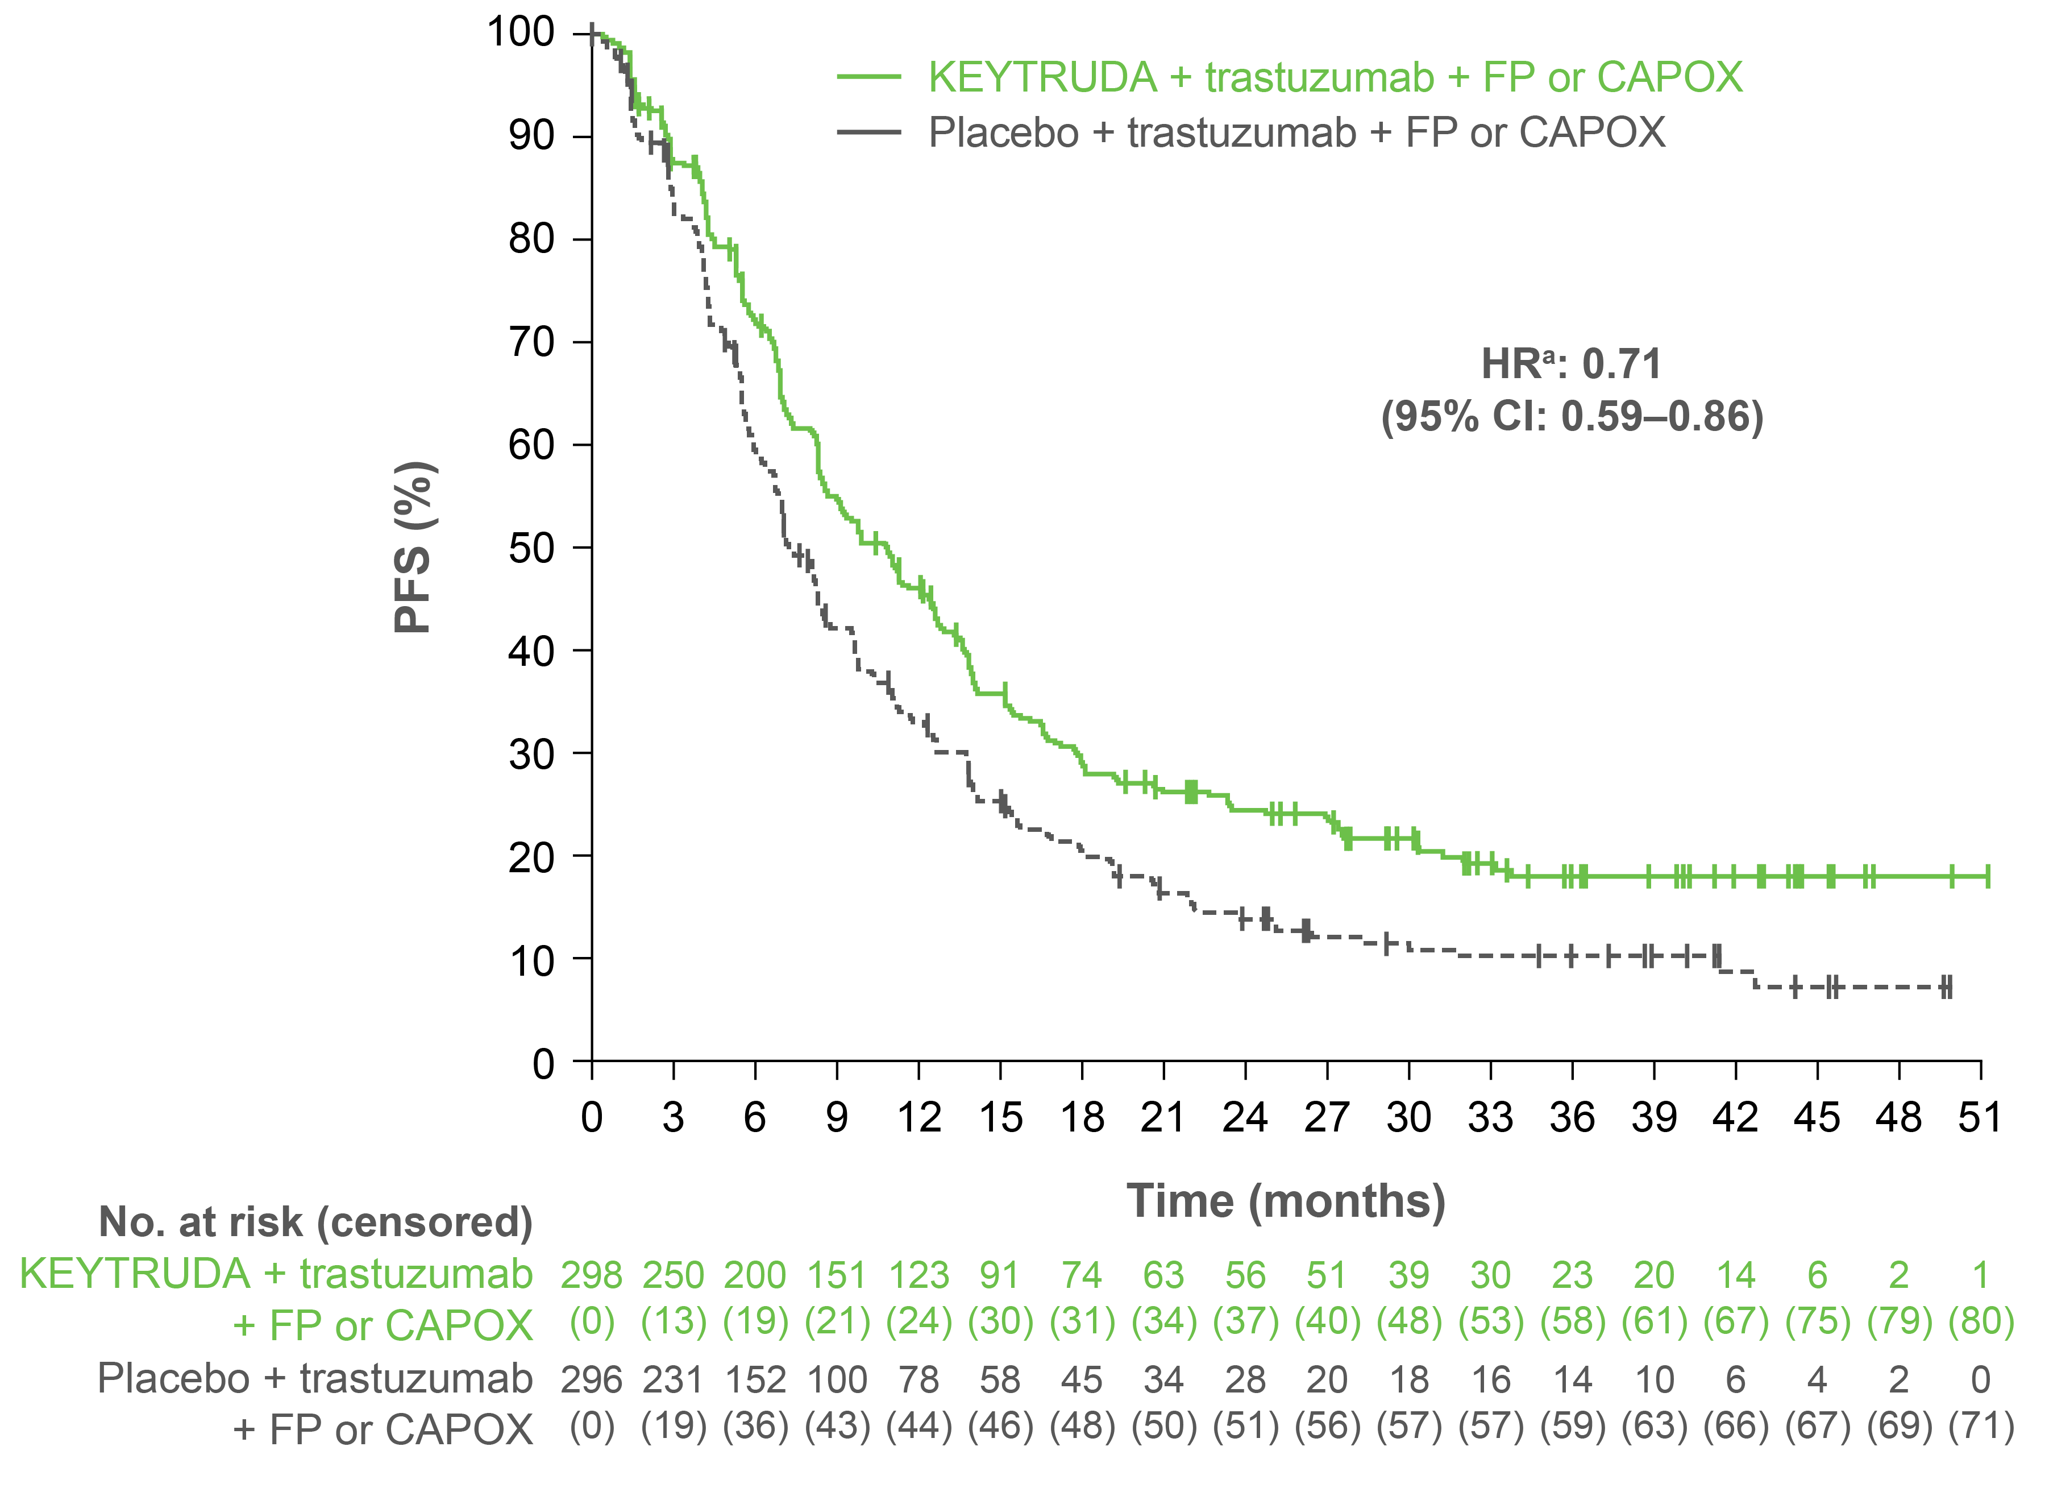
KEYNOTE-811: PFS in patients with PD-L1 CPS ≥1
IA2
At IA2, median PFS in patients with CPS ≥1 was 10.8 for KEYTRUDA + trastuzumab + FP or CAPOX vs 7.2 months for placebo + trastuzumab + FP or CAPOX (HR: 0.70 [95% CI: 0.58–0.85]).
IA3
Median (IQR) follow-up time: 38.5 (29.8–44.4) months
PFS, months | KEYTRUDA + trastuzumab + FP or CAPOX (n=298) | Placebo + trastuzumab + FP or CAPOX (n=296)
Median (95% CI) | 10.9 (8.5–12.5) | 7.3 (6.8–8.5)
LIMITATIONS: These results are from a subgroup exploratory analysis and should be interpreted with caution. Significance was not tested; therefore, no statistical conclusions can be drawn from this analysis.
Figure adapted from Janjigian YY et al. 2023.
GB PI
NI PI

Slide 10
KEYNOTE-811: Primary endpoint – OS in the ITT population
IA2
Median (IQR) follow-up time: 28.4 (19.7–34.3) months
OS, months | KEYTRUDA + trastuzumab + FP or CAPOX (n=350) | Placebo + trastuzumab + FP or CAPOX (n=348)
Median (95% CI) | 20.0 (17.8–23.2) | 16.9 (15.0–19.8)
KEYTRUDA is licensed for use in combination with trastuzumab and chemotherapy for the first-line treatment of locally advanced unresectable or metastatic HER2-positive gastric or GOJ adenocarcinoma in adults whose tumours express PD-L1 with a CPS ≥ 1.
The results for the ITT population are presented as this is the primary endpoint of the study. It allows the results in the licensed population (a sub-group of the ITT population) to be viewed in context of the primary endpoint.
Figure adapted from Janjigian YY et al. 2023.
GB PI
NI PI

Slide 11
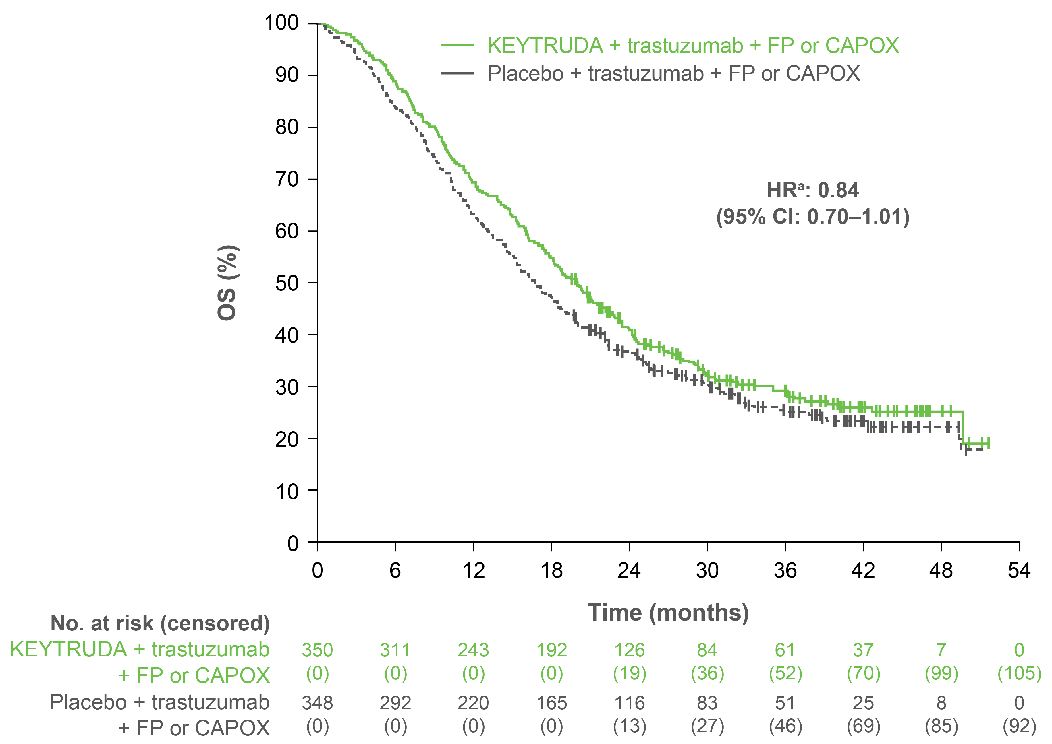
KEYNOTE-811: Primary endpoint – OS in the ITT population
IA3
Median (IQR) follow-up time: 38.5 (29.8–44.4) months
OS, months | KEYTRUDA + trastuzumab + FP or CAPOX (n=350) | Placebo + trastuzumab + FP or CAPOX (n=348)
Median (95% CI) | 20.0 (17.8–22.1) | 16.8 (15.0–18.7)
KEYTRUDA is licensed for use in combination with trastuzumab and chemotherapy for the first-line treatment of locally advanced unresectable or metastatic HER2-positive gastric or GOJ adenocarcinoma in adults whose tumours express PD-L1 with a CPS ≥ 1.
The results for the ITT population are presented as this is the primary endpoint of the study. It allows the results in the licensed population (a sub-group of the ITT population) to be viewed in context of the primary endpoint.
Figure adapted from Janjigian YY et al. 2023.
GB PI
NI PI

Slide 12
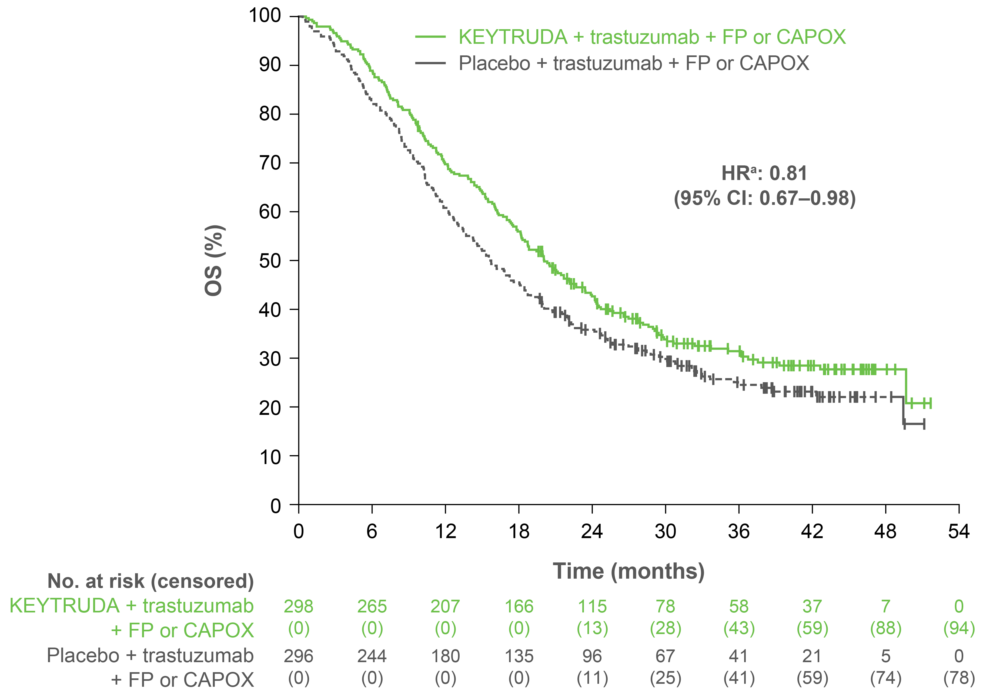
KEYNOTE-811: OS in patients with PD-L1 CPS ≥1
IA2
At IA2, median OS in patients with CPS ≥1 was 20.5 for KEYTRUDA + trastuzumab + FP or CAPOX vs 15.6 months for placebo + trastuzumab + FP or CAPOX (HR: 0.79 [95% CI: 0.64–0.98]).
IA3
Median (IQR) follow-up time: 38.5 (29.8–44.4) months
OS, months | KEYTRUDA + trastuzumab + FP or CAPOX (n=298) | Placebo + trastuzumab + FP or CAPOX (n=296)
Median (95% CI) | 20.0 (17.9–22.7) | 15.7 (13.5–18.5)
LIMITATIONS: These results are from a subgroup exploratory analysis and should be interpreted with caution. Significance was not tested; therefore, no statistical conclusions can be drawn from this analysis.
Figure adapted from Janjigian YY et al. 2023.
GB PI
NI PI

Slide 13
KEYNOTE-811: Secondary endpoint – ORR and DOR in patients with PD-L1 CPS ≥1
IA3
73.2% ORR (95% CI: 67.7–78.1)
16.4% CR
(n=49)
Response duration | KEYTRUDA + FP or CAPOX (n=298) | Placebo + FP or CAPOX (n=296)
Median DOR, months (95% CI) | 11.3 (9.9–13.7) | 9.6 (7.1–11.2)
% with duration ≥24 months | 30.0 | 18.0
58.4% ORR
(95% CI: 52.6–64.1)
10.1% CR
(n=30)
ORR (%)
56.7% PR (n=169)
48.3% PR (n=143)
56.7% PR (n=169)
48.3% PR (n=143)
n=298
n=296
Adapted from Janjigian YY et al. 2023.
GB PI
NI PI

Slide 14
KEYNOTE-811: Safety – AEs in the as-treated population
IA2
Median (IQR) follow-up time: 28.4 (19.7–34.3) months
AE, n (%) | KEYTRUDA + trastuzumab + FP or CAPOX (n=350) | Placebo + trastuzumab + FP or CAPOX (n=346)
Any grade | 347 (99) | 346 (100)
Grade 3–5 | 248 (71) | 225 (65)
TRAEsª | 341 (97) | 334 (97)
Serious | 88 (25) | 79 (23)
Led to death | 4 (1) | 3 (1)
Led to discontinuation of any drug | 124 (35) | 108 (31)
All AEs of interest^{b} | 132 (38) | 83 (24)
Adapted from Janjigian YY et al. 2023.
GB PI
NI PI

Slide 15
KEYNOTE-811: Safety – TRAEs in ≥10% of patients in the as-treated population¹
IA2
Median (IQR) follow-up time: 28.4 (19.7–34.3) months
TRAE,ª n (%) | KEYTRUDA + trastuzumab + FP or CAPOX (n=350) |  | Placebo + trastuzumab + FP or CAPOX (n=346)
Age, median (range), years | Any grade | Grade ≥3 | Any | Grade ≥3
Diarrhoea | 165 (47) | 31 (9) | 145 (42) | 27 (8)
Nausea | 154 (44) | 14 (4) | 152 (44) | 15 (4)
Anaemia | 109 (31) | 21 (6) | 113 (33) | 20 (6)
Decreased neutrophil count | 92 (26) | 28 (8) | 83 (24) | 30 (9)
Decreased appetite | 91 (26) | 11 (3) | 91 (26) | 11 (3)
Decreased platelet count | 89 (25) | 22 (6) | 93 (27) | 23 (7)
Vomiting | 88 (25) | 14 (4) | 86 (25) | 10 (3)
Peripheral sensory neuropathy | 84 (24) | 13 (4) | 73 (21) | 7 (2)
Palmar-Plantar erythrodysaesthesia syndrome | 78 (22) | 5 (1) | 72 (21) | 5 (1)
Fatigue | 69 (20) | 12 (3) | 57 (16) | 8 (2)
TRAE,ª n (%) | KEYTRUDA + trastuzumab + FP or CAPOX (n=350) |  | Placebo + trastuzumab + FP or CAPOX (n=346)
Age, median (range), years | Any grade | Grade ≥3 | Any | Grade ≥3
Increased AST | 66 (19) | 6 (2) | 50 (14) | 1 (<1)
Peripheral neuropathy | 60 (17) | 8 (2) | 63 (18) | 9 (3)
Neutropenia | 59 (17) | 22 (6) | 54 (16) | 16 (5)
Decreased WBC count | 53 (15) | 3 (1) | 41 (12) | 6 (2)
Increased ALT | 51 (15) | 3 (1) | 41 (12) | 1 (<1)
Decreased weight | 42 (12) | 5 (1) | 24 (7) | 2 (1)
Thrombocytopenia | 40 (11) | 11 (3) | 44 (13) | 6 (2)
Asthenia | 39 (11) | 7 (2) | 50 (14) | 9 (3)
Increased blood bilirubin | 39 (11) | 3 (1) | 27 (8) | 2 (1)
Stomatitis | 36 (10) | 4 (1) | 31 (9) | 6 (2)
Tables adapted from Janjigian YY et al. 2023.
The safety profile at IA2 and IA3 was similar to that observed at IA1 and in other trials assessing KEYTRUDA in combination with chemotherapy^{1,2}
GB PI
NI PI

Slide 16
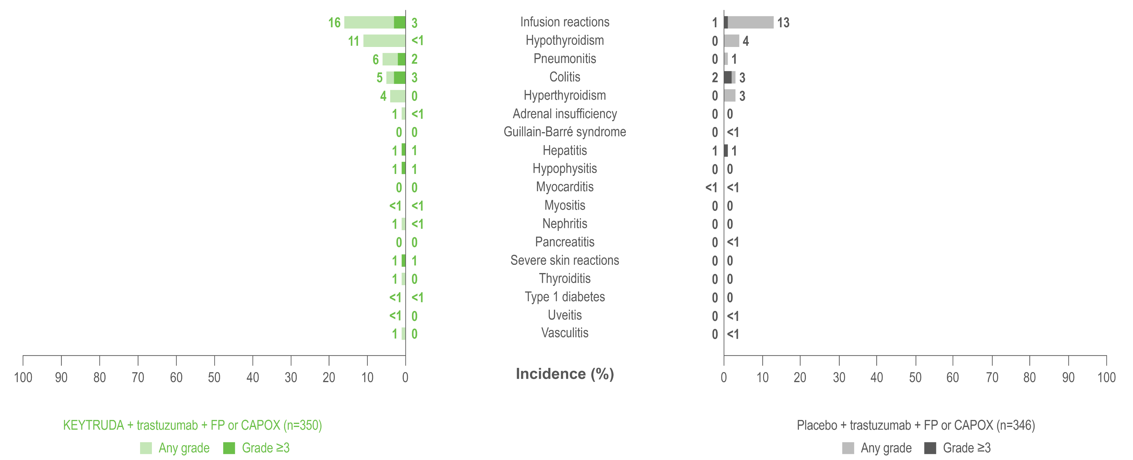
KEYNOTE-811: Safety – AEs of interestª
IA2
Median (IQR) follow-up time: 28.4 (19.7–34.3) months
Adapted from Janjigian YY et al. 2023.
GB PI
NI PI

Slide 17
KEYNOTE-811: Summary
In patients with PD-L1 CPS ≥1, there was a 3.6-month difference at IA3 in median PFS with KEYTRUDA + trastuzumab + FP or CAPOX (10.9 months) vs placebo + trastuzumab + FP or CAPOX (7.3 months); HR: 0.71 (95% CI: 0.59–0.86)¹
At IA3, OS among patients with PD-L1 CPS ≥1 was numerically longer with KEYTRUDA + trastuzumab + FP or CAPOX (20.0 months) vs placebo + trastuzumab + FP or CAPOX (15.7 months); HR: 0.81 (95% CI: 0.67–0.98)¹
The final OS analysis is planned for ≥28 months after randomisation of the last patient¹
The safety profile at IA2 and IA3 was like that observed at IA1 for this trial assessing KEYTRUDA in combination with trastuzumab + FP or CAPOX^{1,2} with no new safety signals.
GB PI
NI PI

Slide 18
Pembrolizumab dosing^{1,2}
Patients should be treated with pembrolizumab until disease progression or unacceptable toxicity
Atypical responses (i.e. an initial transient increase in tumour size or small new lesions within the first few months followed by tumour shrinkage) have been observed
It is recommended to continue treatment for clinically stable patients with initial evidence of disease progression until disease progression is confirmed
No dose reductions of pembrolizumab are recommended. Pembrolizumab should be withheld or discontinued to manage AEs as described within the SmPC
When administering pembrolizumab in combination with intravenous chemotherapy, pembrolizumab should be administered first
Every 3 weeks
Administered as an IV infusion
Adults: 200 mg
Over 30 minutes
Every 6 weeks
Adults: 400 mg
The only regimen assessed in all clinical Phase 2 and 3 registration studies for KEYTRUDA was the 200 mg Q3W dosing. The study that led to the approval of the Q6W for monotherapy and combination patients assessed the 400 mg Q6W dosing schedule based on an exposure–response evaluation using modelling and simulation. It concluded that the 400 mg Q6W dosing regimen for KEYTRUDA monotherapy and combination is predicted to have a similar efficacy and safety profile as the approved 200 mg Q3W dosing regimen²
5-FU, 5-fluorouracil; AE, adverse event; IV, intravenous; Q3W, every 3 weeks; Q6W, every 6 weeks; SmPC, Summary of Product Characteristics. 1.KEYTRUDA (pembrolizumab) SmPC. KEYTRUDA (pembrolizumab) SmPC. Available at: https://www.emcpi.com/pi/33162 (GB) and https://www.emcpi.com/pi/ni/378 (NI). Accessed March 2022. 2. Lala M et al. Eur J Cancer 2020;131:68–75.

Slide 19
Appendix
GB PI
NI PI

Slide 20
HER2 testing can help identify patients with gastric or GOJ adenocarcinoma eligible for HER2-targeted treatment^{1,2}
Test for HER2 protein overexpression by IHC
Negative (0)
Negative (1+)
Equivocal (2+)
Positive (3+)
Test for HER2 gene amplification by FISH
Negative
for HER2 gene amplification
Positive
for HER2 gene amplification
Eligible for HER2-positive targeted treatment
Figure adapted from Abrahao-Machado LF al. 2016.
IHC or FISH tests are used to identify cancer cells with a high level of the HER2 protein¹
Patients with HER2-postive gastric or GOJ cancer with a PD-L1 CPS ≥1 are eligible for KEYTRUDA treatment in addition to trastuzumab and chemotherapy²
GB PI
NI PI

